Slide 1
Disney | Stock Factor Analysis.
June 30, 2020

Slide 2
Agenda.
Question.
Analyses.
Summary.
What’s next?

Slide 3
The Walt Disney Corporation represented 38% of the US film market in the year 2019, making it the dominant force in American film production. However, theatrically released films make up only a fraction of Disney’s revenue. Our team will look at Disney’s financial statistics and find out which factors most impact the Walt Disney corporation’s market value. We will examine internal factors, like film and online release statistics, as well as more external ones, like unemployment and greater market trends. This will allow our team to examine what has the greatest impact on the most dominant company in entertainment.

Slide 4
Question.
What are some of the factors that affect the price of Walt Disney Company stock?

Slide 5

Why?
Walt Disney Company
The Walt Disney company is a diverse company that’s more than just an animated film producer.
We wanted to look at if a successful box office could affect the stock price along with other internal and external factors.

Slide 6
Gross Profits and Revenue
We wanted to have a baseline for further analysis, so first we examined the most logical elements to impact the Walt Disney price. To do so we analyzed the Disney’s quarterly reports.

Slide 7
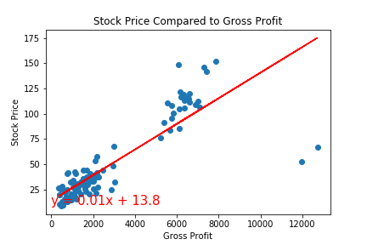
Gross Profits vs. Stock Price
Comparing the gross profits to the share price quarterly, we can see a strong positive correlation just in the graph itself.
The correlation between these two variables in the data set: .85.

Slide 8
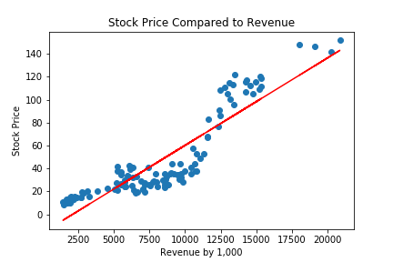
Revenue vs Stock Price
Reported revenue is even more correlated to the quarterly stock price.

Slide 9
Analyses.
Newsworthiness.
Based on New York Times articles, does the number of articles per week represent the magnitude of change in the stock price?

Slide 10
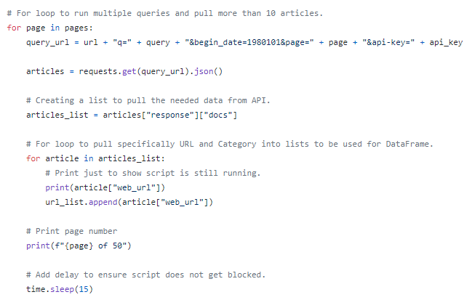
Data.
New York Times article API.
In order to pull the number articles per week, we had to create a looped python script that would request 50 pages (500 articles) from the Article Search API.

Slide 11
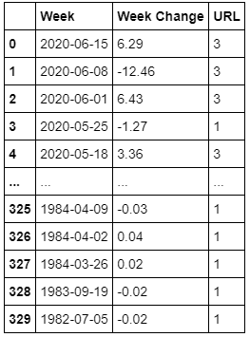
Data.
Combined data.
With historical stock price data, we were able to create a table that calculated the change in price during a specific week, along with the number of NYT articles based on publish date.

Slide 12
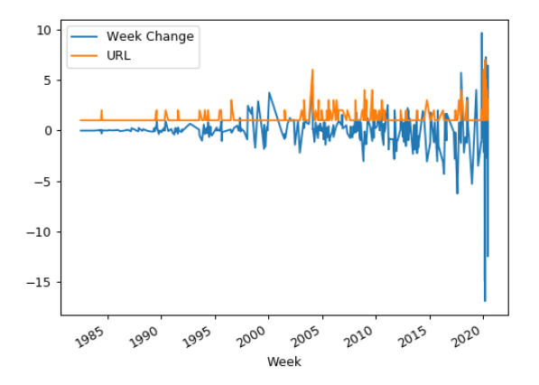
Data.
Plot.
With a quick eye test, we see occurrences of the two lines spiking together. Since we are just looking for change (positive or negative), anytime the article count spikes, we should see fluctuation with the stock price.

Slide 13
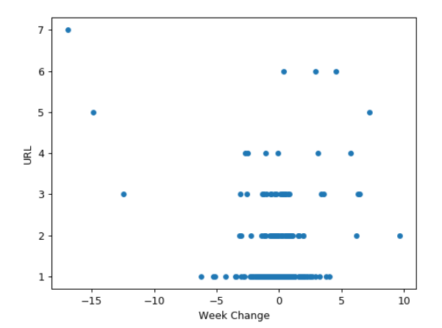
Data.
Plot again.
Using a scatter plot, we see that as we move higher up in article count, the more we see points move towards the sides, representing a large stock price change.

Slide 14
Data.
Relevant?
Insert chart for score.
Do the math calculations to see if there is correlation.

Slide 15
Summary.

Slide 16
Summary.
From the 5 factors we looked at, we determined # of them have a relationship with the stock price.

Slide 17
What’s next?

Slide 18
What’s next?
Look into more factors.
Connect the different factors.
Send to Walt Disney Company.
Become millionaires.

